Slide 1
Malaria Detection Capstone Project Final Presentation
Yu-Chen Hwang, Ph.D.
4/17/2022

Slide 2
Executive Summary - Key Learnings
Malaria affects about 50% of the world population and an automated screening for cells infected with the parasite is warranted to prevent death
Dataset is well curated – no missing data & both uninfected and parasitized cells are evenly distributed.
Data transformation or augmentation did not improve model performance
Transfer learning using pre-trained model such as VGG16 and ResNet also did not improve performance
Model fitting might stop before the training accuracy stabilizes with Callbacks. For pre-trained models, removing Callbacks and fitting the model over the entire iteration resulted in better performance
Model should aim to maximize recall value to minimize false negative as failing to diagnose malaria patients have much dire consequences
The developed model is useful for pre-screening of malaria infected cells at high-throughput

Slide 3
Problem & Solution Summary - Problem Statement
Context
About 50% of the world’s population is in danger of malaria, a severe infectious disease caused by Plasmodium parasite transmitted through mosquitoes.
There are more than 229 million malaria cases and 400,000 malaria-related death worldwide in 2019. Children under five are the most vulnerable population and they accounted for 67% of the total mortality.
Malaria is treatable; however, the treatment success relies on early diagnosis of malarial parasites. Hence, the need for an automated method for accurate, early detection of the parasite that can lead to effective treatment regiment.
Objectives
Conventional malaria detection method required a qualified pathologist manually inspecting blood smears collected from the patient and score the test results. This process is labor intensive, time consuming, expansive, and prone to human error
This project is to develop a robust model using Deep Learning algorithm for automated detection of malaria parasite in the blood smear samples to reduce cost and achieve high screening throughput.
Key questions
What is the acceptable type I and type II error
What is the respective training, validation accuracy of the model
Which method we should use to build the model
Is the algorithm computationally expansive
Problem formulation
Build a robust and efficient machine learning model to detect malaria – determine if the image of a red blood cell is infected with the parasite or not.

Slide 4
Problem & Solution Summary - Data Exploration
Overview
Images in the training and test sets have the same dimensions - 64 x 64 pixels in 8-bit RGB
Number of images matches the number of labels
Total of 24,958 training and 2,600 test images taken from microscopic images
These images are labeled in two classes:
Parasitized: The parasitized cells contain the Plasmodium parasite which causes malaria
Uninfected: The uninfected cells are free of the Plasmodium parasites
Key patterns
No missing data and all images are labeled
Some images might not be labeled correctly
Images in both classes are evenly distributed – close to 50-50 split in both train and test sets
Red blood cells have different shape and hue. Uninfected cells have relatively even color and intensity distribution; while the parasitized cells have dark purple (more red than blue) patches within the cell.
Randomly selected images showed that there might be some mis-labeled images in the training set, which might affect the result. However, data validation is beyond the scope of this project - we just need to be mindful about the possibility of incorrectly labeled data. This observation helps to explain model accuracy.
Data process
Normalize the images so the intensity scale is between 0 and 1

Slide 5
Problem & Solution Summary - Tested Models
Base Model
Three sequential layers for feature extraction and two dense layers for classification.
Impose regularization to mitigate overfitting
Sigmoid
Use Sigmoid activation function in the output layer
4CONV
Add an additional convolution layers for feature extraction
HSV
Convert RGB images to HSV
Build 4CONV model
Augmentation
Augment data using image data generator
Build 4CONV model
VGG16
Use pre-trained VGG16 model with additional classification layers
ResNet
Use pre-trained ResNet 101 v2 model with additional classification layers

Slide 6
Problem & Solution Summary - Model Performance

Slide 7
Problem & Solution Summary - Model Training Time & Total Parameters

Slide 8
Recommendation for Implementation - Final Solution Design
4CONV model is the best performing model
This model comprises 4 convolution layers and 2 dense layer, resulting in 278,530 total parameters
Highest test accuracy and recall score - test accuracy is 0.98, precision is 0.99, recall is 0.98, and f1-score is 0.988
Simplest model tested - the total parameters is about 25% of the base model and less than 1% of the pre-trained models. Easy to implement.
Computationally efficient - model training took less than 1 min to complete, the fastest process amongst the tested models. Fast to improve training with additional data.
To improve this model even further will require validating all labeled images before feeding them to the model. The main challenge for DL technique is the need for accurately labeled data - although this is out of scope for this project, accurately label the ground truth objects is the key factor in building a robust model.
This simple model can be adapted to screen other blood born parasites, such as Babesia, using the target-specific image and label sets

Slide 9
Appendix

Slide 10
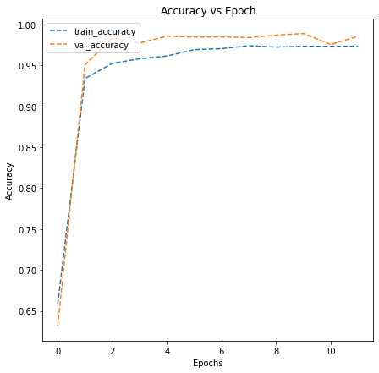
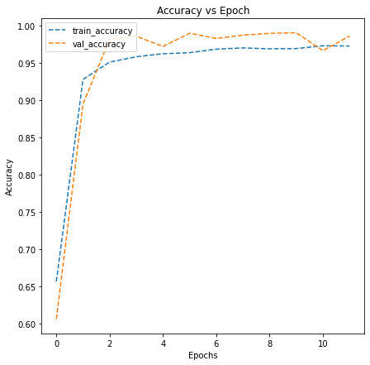
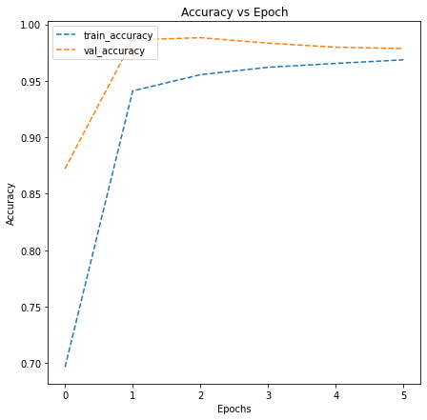
Accuracy vs Epoch Plot – Variation of Base Models
Base Model
Sigmoid Model
4CONV Model

Slide 11
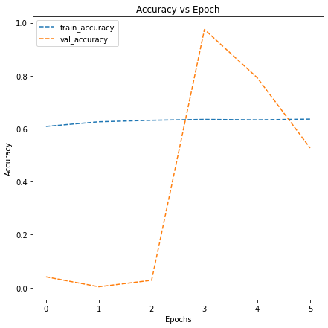
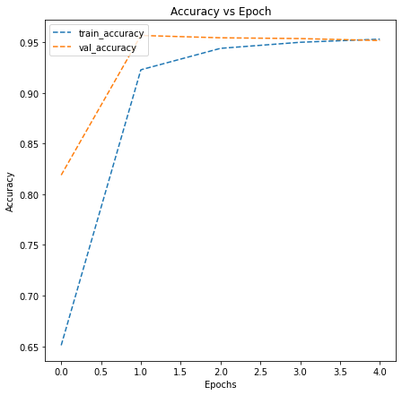
Accuracy vs Epoch Plot – Data Transformation
HSV Model
AUG Model

Slide 12
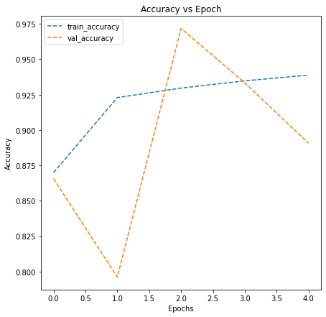
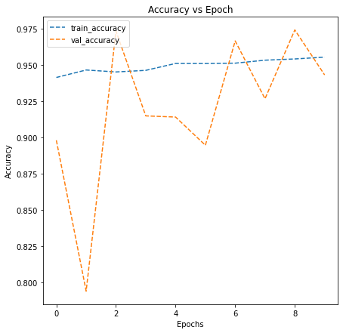
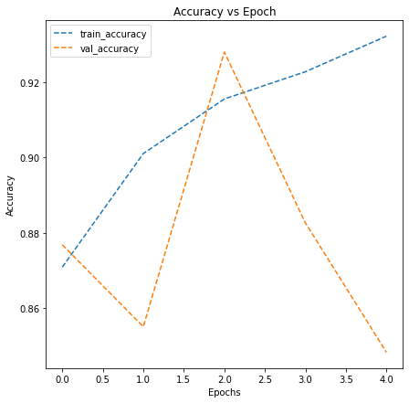
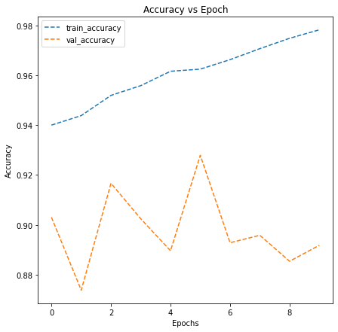
Accuracy vs Epoch Plot – Transfer Learning
VGG Model with Callbacks
VGG Model w/o Callbacks
ResNet Model with Callbacks
ResNet Model w/o Callbacks

Slide 13
VGG Model with Callbacks
VGG Model w/o Callbacks
ResNet Model
ResNet Model w/o Callbacks

